Slide 1

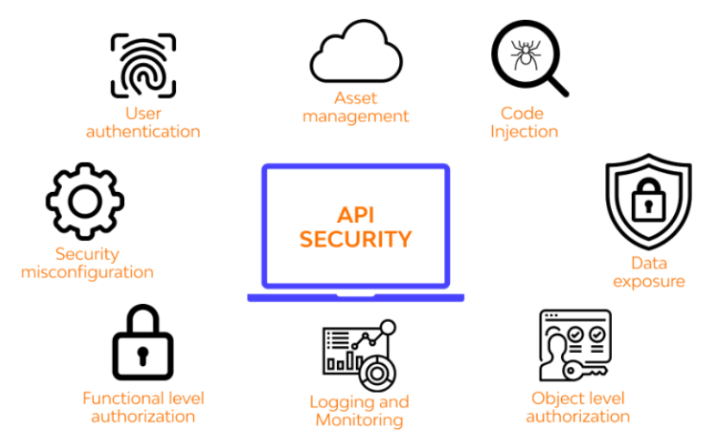
Foundations of API Authentication and Authorization

Slide 2

Topics :
What is Authentication and Authorization?
Types of Authentication Methods :
API Key Authentication
JWT (JSON Web Token)
Oauth 2.0
Comparing API Key vs JWT vs OAuth
When to Use Which Method?

Slide 3

1. What is Authentication and Authorization?
1. Authentication = "Who are you?"
It is the process of verifying the identity of the user.
Example:
When a user provides an API key or token, we check if it's valid.
If yes → authenticated.
If no → request is blocked.

Slide 4
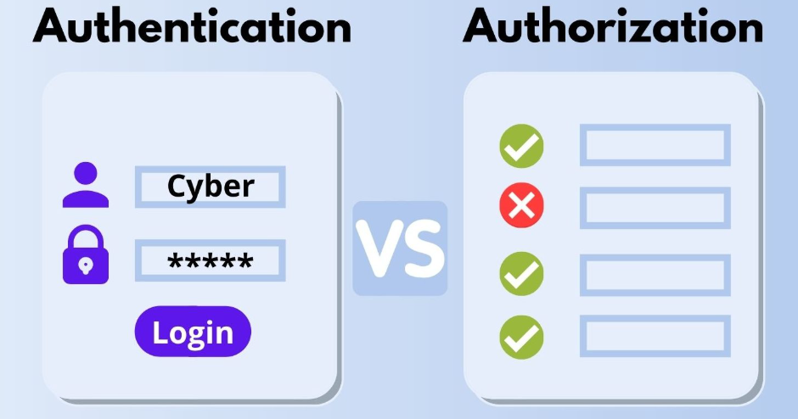
1. What is Authentication and Authorization?
2. Authorization = "Are you allowed to do this?"
After verifying the user, authorization determines
what they can access.
Example:
Admin can access /upload and /delete.
Normal user can only access /view.

Slide 5

1. What is Authentication and Authorization?
3. Middleware = Gatekeeper for every request
Middleware is a piece of code that runs before your route and can:
Check for authentication
Validate tokens/API keys
Reject unauthorized users

Slide 6
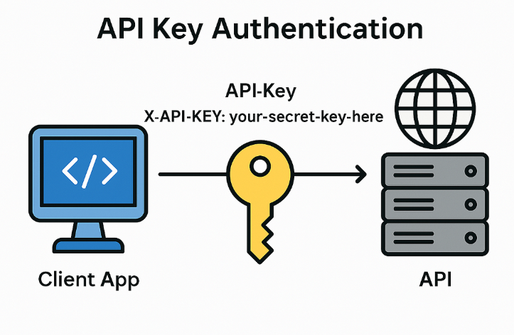
2. Types of Authentication Methods
API Key Authentication
JWT (JSON Web Token) Authentication
OAuth 2.0 Authentication

Slide 7
2. Types of Authentication Methods
1. API Key Authentication :
How It Works?
A unique key is generated and assigned to the client (user or app).
The client sends this API key with each request.
The server verifies the key and grants access.
Example (Using API Key in Header)
GET /data HTTP/1.1
Host: myapp.com
Authorization: Api-Key 123456789abcdef
Example (Using API Key in Query Parameter - Not Recommended)
GET https://example.com/data?api-key=123456789abcdef

Slide 8
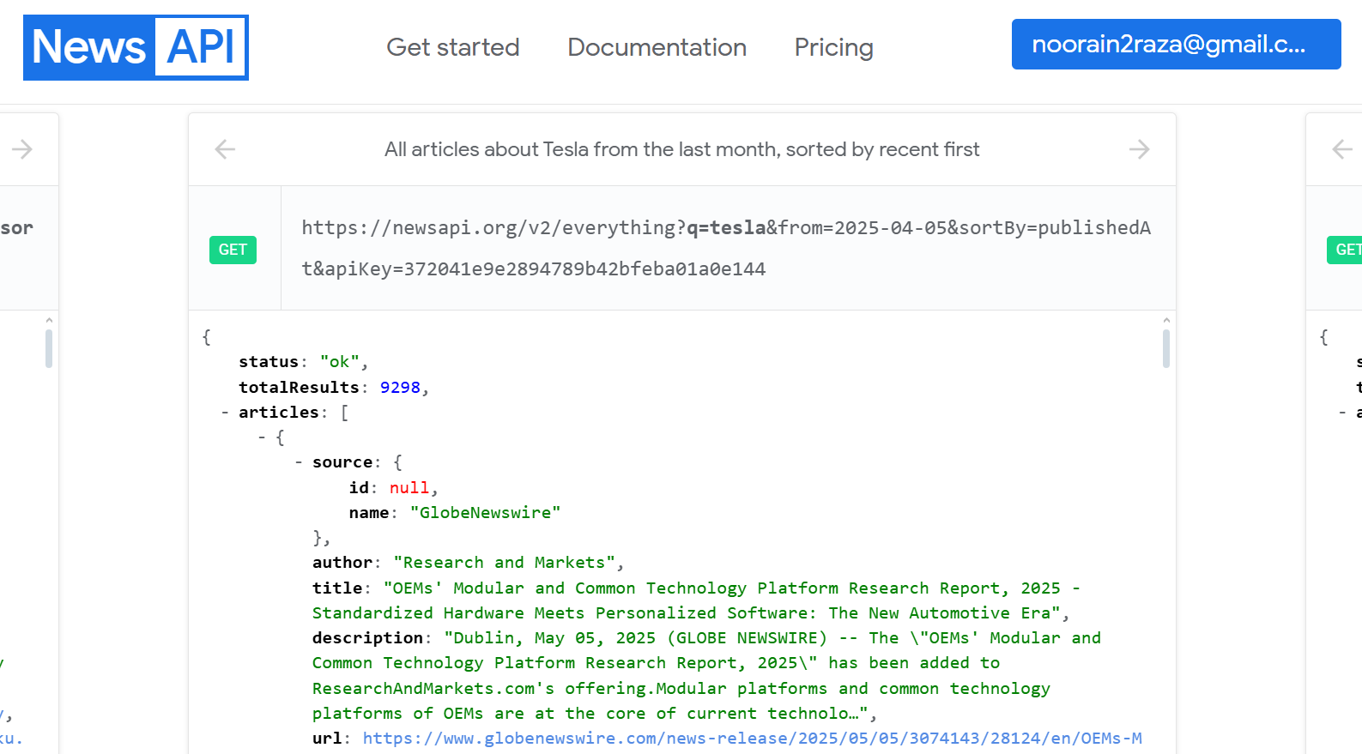
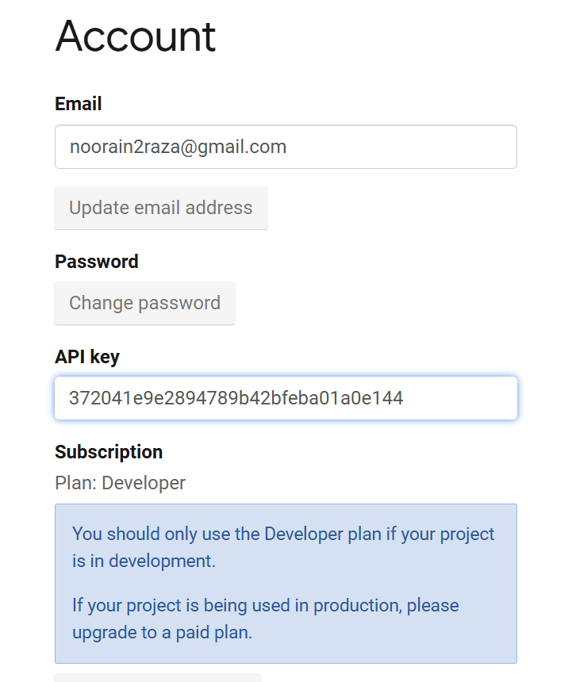
2. Types of Authentication Methods
News api ex-

Slide 9
2. Types of Authentication Methods
2. JWT (JSON Web Token) Authentication
This token consists of three parts:
1) header
2) payload
3) signature
A JWT looks like this:
eyJhbGciOiJIUzI1NiIsInR5cCI6IkpXVCJ9.eyJ1c2VySWQiOiIxMjMiLCJuYW1lIjoiSm9obiBEb2UifQ.s5aZ

Slide 10
2. Types of Authentication Methods
Header (Metadata)
{
"alg": "HS256",
"typ": "JWT"
}

Slide 11
2. Types of Authentication Methods
Payload (User information)
{
"user-id": 123,
"role": "admin",
"iat": 1691855200,
"exp": 1691858800
}

Slide 12
2. Types of Authentication Methods
The Signature Component in JWT :
The signature in a JSON Web Token (JWT) ensures data integrity and authenticity—meaning:
The token has not been tampered/changed with after it was created.
The token was issued by a trusted source (i.e., a server that holds the secret signing key).

Slide 13
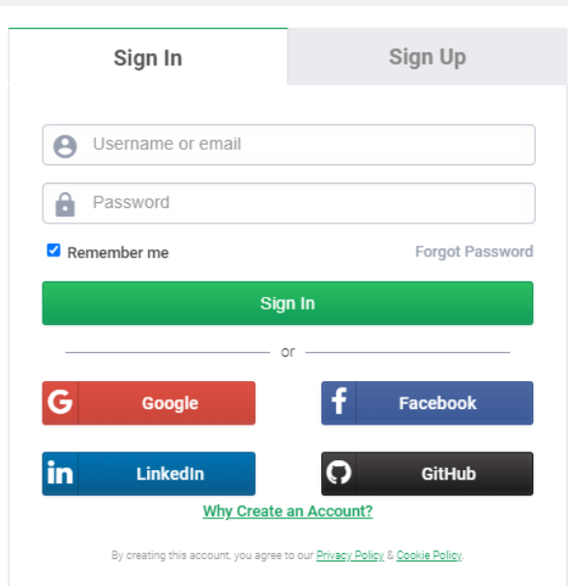
2. Types of Authentication Methods
3. OAuth 2.0 Authentication
How It Works?
OAuth 2.0 is an authorization framework that allows access without sharing credentials.
It is a token based authentication system.
It issues an Access Token instead of a password.
Tokens have an expiry time for better security.

Slide 14
2. Types of Authentication Methods
Steps Involved:
1. User logs in → API sends Authorization Code. 2. The app exchanges this code for an Access Token. 3. The client includes the Access Token in API requests. 4. API verifies the token and grants access.

Slide 15
3. Comparing API Key vs JWT vs OAuth
Method | Best For | Security | Ease of Use
API Key | Server-to-server | 🔴 Low | 🟢 Easy
OAuth 2.0 | Third-party login (Google, Facebook) | 🟢 High | 🔴Complex
JWT | Web & mobile apps | 🟢 High | 🟢 Moderate

Slide 16
4. When to Use Which Method?
Recommended:
Public APIs → API Key or OAuth 2.0
Secure APIs → OAuth 2.0 or JWT

Slide 17
Thanks!

